Slide 1
OpenAI Agents SDK - Open Source
Playlist link https://www.youtube.com/playlist?list=PL0vKVrkG4hWovpr0FX6Gs-06hfsPDEUe6

Slide 2
Inner working of OpenAI Agents SDK | Deep Dive
Sir Asharib class link ➔ https://www.youtube.com/live/5RIADVKVEd8 (unlisted)
Complete video link ➔ https://www.youtube.com/watch?v=Xkg6JBUFkPY
Sir made guide for inner working ➔ https://github.com/AsharibAli/agentic-ai-projects/blob/main/openai_agents_sdk.md

Slide 3
Core Concepts of Agent
To see tracing (while you are using openAI API) go to this link https://platform.openai.com/docs/overview ➔ dashboard ➔ tracing section, here you will see the entire workflow of agents you run till date.
When you used openai models (which are paid) to make agents, you will get tracing functionality by default on above link
If you used Gemini or any other model in openai sdk, you will need to used some tracing provider in order to trace it.

Slide 4
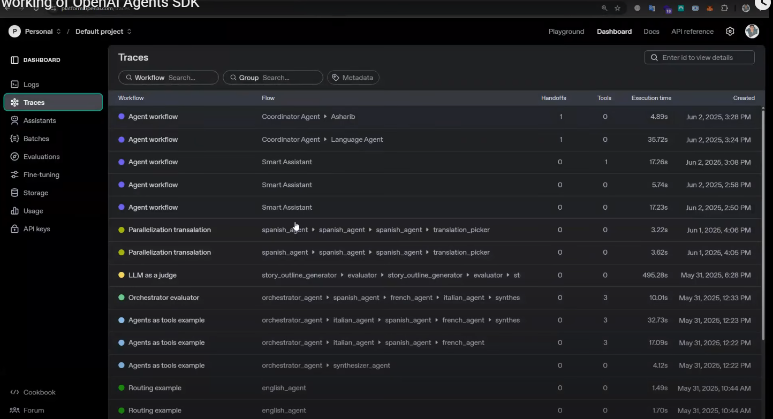
Core Concepts of Agent

Slide 5
Tools
Tools are simple python functions which will build to implement custom logic
Litellm is simple which helps to access different provider tools, like Gemini, Anthropic etc.
OpenAI called their latest APIs as:
Response API ➔ https://platform.openai.com/docs/api-reference/responses
Completion API ➔ https://platform.openai.com/docs/guides/completions
Assistant API ➔ https://platform.openai.com/docs/assistants/

Slide 6
Open AI SDK
What is the OpenAI SDK?
A Software Development Kit that simplifies integration with OpenAI’s APIs.
Offers tools and abstractions to interact with models like GPT-4, DALL-E, Whisper, etc.
Enables rapid development of AI-powered applications in various programming environments.
Release on 11th March 2025 by OpenAI

Slide 7
Open AI SDK
Key Features
Easy-to-use API client in popular languages (Python, JavaScript, etc.)
Supports:
Chat Completions (GPT models)
Image Generation (DALL·E)
Audio Transcription (Whisper)
Embeddings
File and fine-tuning operations
Built-in support for streaming, error handling, and retries.
Python-First Design
Built-in Agent Loop
Interoperability
Simplified Multi-Agent Workflows
Real-World Applications

Slide 8
Open AI SDK
Why Use It?
Speeds up development with minimal boilerplate code.
Officially maintained and optimized by OpenAI.
Ensures compatibility with OpenAI’s latest features and API changes.
How to Get Started
Install via package manager (e.g., pip install openai)
Authenticate with API key
Use pre-built functions for common tasks

Slide 9
Core Concepts : The Power of Simplicity in Design
The Agents SDK is designed to be easy to use but also powerful. It’s built around 4 main parts:
Agents
Smart AI assistants (LLMs) with instructions, tools (like web search), and safety rules. They understand tasks and take actions.
Pre-built AI models with custom instructions and tools.
Can understand tasks and respond intelligently.
Follow built-in safety rules for reliable output.

Slide 10
Core Concepts : The Power of Simplicity in Design
Handoffs
Agents can pass tasks to other agents if needed—like teamwork between AI assistants.
Agents can transfer tasks to other, more specialized agents.
Enables teamwork between multiple agents.
Helps handle complex or multi-step tasks more efficiently.
Guardrails
Safety checks that control what agents can say or do, helping avoid mistakes or risks.
Safety checks on what the agent can say or do.
Prevents harmful, incorrect, or risky outputs.
Keeps the AI working within set boundaries.

Slide 11
Core Concepts : The Power of Simplicity in Design
Tracing & Observability
Helps you see what the agent is doing, step by step—great for debugging and improving your app.
Shows a clear step-by-step view of what the agent is doing.
Helps developers debug, monitor, and improve performance.
Makes it easier to understand and control agent behavior.

Slide 12
OpenAI’s SWARM framework
Origins & Concept
The idea of multi-agent collaboration has been explored in AI research for years.
OpenAI began experimenting with agent collaboration to handle complex, multi-step tasks more efficiently.
Initial concept of SWARM emerged in 2023, around the same time OpenAI introduced its Agents and tool-use features.
Internally, OpenAI ran experiments where multiple agents (GPT-based) worked together to solve tasks like coding, planning, and research.
The term “SWARM” became more publicly known in late 2023 to early 2024 through: Research talks, OpenAI demonstrations, Community interest in multi-agent collaboration
SWARM is still experimental, not yet a formal product.

Slide 13
OpenAI’s SWARM framework
What is SWARM?
SWARM is a new experimental framework from OpenAI for building multi-agent systems.
It lets multiple AI agents work together like a team to solve complex tasks.
Inspired by how humans collaborate, using division of labor, communication, and coordination.
Key Goals
Scalability: Break large tasks into smaller subtasks for agents to handle.
Specialization: Use different agents with different skills.
Autonomy + Collaboration: Agents work independently but coordinate as a team.

Slide 14
OpenAI’s SWARM framework
How SWARM Works
OpenAI’s experimental Swarm framework is meant more as an educational tool than a production-ready system—but it introduces several key design patterns for orchestrating multi-agent systems. In Swarm, agents aren’t monolithic; instead, they’re designed with specialized roles and communicate through clearly defined patterns. Here are some of the core design patterns:
1. Prompt Chaining (Chain Workflow):
This pattern involves breaking down complex tasks into a sequence of simpler, manageable steps, where each step builds upon the previous one. The Agents SDK supports this by allowing developers to define agents that execute specific functions in a predetermined order, ensuring a structured approach to task completion.
2. Routing:
Routing entails directing tasks to the most appropriate agent based on the task's nature. The Agents SDK facilitates this through its handoff mechanism, enabling agents to transfer control to other agents better suited to handle specific subtasks, thereby optimizing task management.

Slide 15
OpenAI’s SWARM framework
3. Parallelization:
This pattern focuses on executing multiple subtasks concurrently to enhance efficiency. With the Agents SDK, developers can design agents that operate in parallel, leveraging the SDK's orchestration capabilities to manage simultaneous processes effectively.
4. Orchestrator-Workers:
In this design, an orchestrator agent decomposes a complex task into smaller subtasks and assigns them to worker agents. The Agents SDK's architecture supports this by allowing an orchestrator agent to oversee the workflow and delegate tasks to specialized worker agents, ensuring coordinated task execution.
5. Evaluator-Optimizer:
This pattern involves iterative improvement through feedback loops, where an evaluator agent assesses the performance of other agents and suggests optimizations. The Agents SDK's guardrails feature enables the implementation of such evaluative mechanisms, allowing for continuous performance enhancement and adherence to desired behaviors.

Slide 16
OpenAI’s SWARM framework
Core Components
Benefits of SWARM
Handles complex, multi-step problems
Encourages AI teamwork
Easier to debug and understand workflows
Supports modular development (add or replace agents as needed)
Component | Description
Agent | Language models with specific instructions or skills.
Tasks | Jobs assigned to agents, can be split or passed.
Workspace | Shared space where agents read/write info (like a whiteboard).
Tools | External actions agents can use (e.g., web, code, memory).
Communication | Messaging system between agents to share progress or ask for help.

Slide 17
OpenAI’s SWARM framework
Example Use Cases
Research assistants collaborating on a report.
Customer service agents working together on complex tickets.
Writing, coding, or brainstorming as a group of specialists
Current Status
Still in experimental stages (as of 2024–2025)
Not public yet — demonstrated internally by OpenAI
Possible future feature in OpenAI’s Agents SDK

Slide 18
UV
uv is a modern Python package manager and build system developed by Astral (formerly part of the pdm project). It is designed to be extremely fast, reliable, and easy to use, and is built in Rust for performance.
Key Features of uv:
Ultra-Fast: Much faster than pip and poetry due to being written in Rust.
Unified Tooling: Acts as a drop-in replacement for pip, virtualenv, and pip-tools.
Deterministic Installs: Ensures reproducible builds by resolving dependencies into lockfiles.
PEP 582 Support: Supports local package installation without virtual environments.

Slide 19
Chainlit
Chainlit is an open-source Python framework designed to build and share conversational AI apps powered by LLMs (Large Language Models). It allows developers to quickly create, test, and deploy AI assistants with a front-end interface — all from Python.
Key Features of uv:
UI Built-In: Auto-generates a chat user interface — no front-end needed.
LLM Support: Works with OpenAI, Hugging Face, LangChain, and others.
Fast Prototyping: Build LLM-powered apps in minutes.
Realtime Interaction: Supports async messages, tool use, and streaming.
Developer Tools: Logs, debugging, and interaction tracing included.

Slide 20
Making first Agent using Gemini API
Learn_agentic_ai/01_ai_agent_first:
We have covered step 05_chainlit and 06_chatbot/chatbot in it
We have made chatbot one on google colab and other on VS code/cursor using chainlit
Below is the link of google colab working
https://colab.research.google.com/drive/1mkYAOwlC0yaV0ho2N2BbMZrgXDRGWnaX#scrollTo=-j2Nfiz_C83g
We have also worked on hello_agent using chainlit when present in folder

Slide 21
07_streaming
Streaming means the chatbot shows you its response word-by-word or phrase-by-phrase, almost as it's thinking, instead of making you wait for the entire answer to be calculated and then displayed all at once.
Why is this good?
Faster perception: You see a response sooner, which feels faster even if the total time is the same.
More engaging: It's more like a conversation with a real person because you're seeing the answer develop.
Handles longer answers better: Long responses feel less daunting when they appear gradually.
Check folder and repo for code Repo link ➔ https://github.com/panaversity/learn-agentic-ai/tree/main/01_ai_agents_first/07_streaming

Slide 22
08_tools
The OpenAI Agents SDK provides a robust framework for integrating various tools into agents, enabling them to perform tasks such as data retrieval, web searches, and code execution. Here's an overview of the key points regarding tool integration:
Types of Tools:
1. Hosted Tools: These are pre-built tools running on OpenAI's servers, accessible via the [OpenAIResponsesModel]. Examples include:
WebSearchTool: Enables agents to perform web searches.
Try it in Colab: File Search Tool Example
FileSearchTool: Allows retrieval of information from OpenAI Vector Stores.
Try it in Colab: Computer Tool Example
ComputerTool: Facilitates automation of computer-based tasks.
We will use model=computer-use-preview-2025-03-11
Note: The model "computer-use-preview" is not available.
2. Function Calling: This feature allows agents to utilize any Python function as a tool, enhancing their versatility.
3. Agents as Tools: Agents can employ other agents as tools, enabling hierarchical task management without transferring control.
Check Repo for detail ➔ https://github.com/panaversity/learn-agentic-ai/tree/main/01_ai_agents_first/08_tools

Slide 23
OPENAI Documentation Github Page
Below is the link of document
https://openai.github.io/openai-agents-python/
Why use the Agents SDK
The SDK has two driving design principles:
Enough features to be worth using, but few enough primitives to make it quick to learn.
Works great out of the box, but you can customize exactly what happens.

Slide 24
OPENAI Documentation Github Page
Here are the main features of the SDK:
Agent loop: Built-in agent loop that handles calling tools, sending results to the LLM, and looping until the LLM is done.
Python-first: Use built-in language features to orchestrate and chain agents, rather than needing to learn new abstractions.
Handoffs: A powerful feature to coordinate and delegate between multiple agents.
Guardrails: Run input validations and checks in parallel to your agents, breaking early if the checks fail.
Function tools: Turn any Python function into a tool, with automatic schema generation and Pydantic-powered validation.
Tracing: Built-in tracing that lets you visualize, debug and monitor your workflows, as well as use the OpenAI suite of evaluation, fine-tuning and distillation tools.

Slide 25
@dataclass
Understanding Python Dataclasses
Dataclasses, introduced in Python 3.7, are a powerful way to create classes primarily used to store data.
They reduce boilerplate code often associated with defining classes for data storage, such as __init__, __repr__, __eq__, and __hash__ methods.
Why Use Dataclasses?
Before dataclasses, you might have used plain classes or namedtuple for data structures. While functional, they often required a lot of repetitive code.
Dataclasses simplify this by automatically generating common methods based on type hints.

Slide 26
@dataclass
Benefits of Dataclasses:
Less Boilerplate: Automatically generates __init__, __repr__, __eq__, __hash__ (if mutable=False), and __str__.
Readability: Clearly defines the fields and their types, making the code easier to understand.
Type Hinting: Integrates seamlessly with type hints, improving static analysis and code clarity.
Mutable by Default: Unlike namedtuple, dataclasses are mutable by default, but you can make them immutable.
Default Values: Easy to assign default values to fields.
Basic Usage
To create a dataclass, you import the dataclass decorator from the dataclasses module and apply it to your class.
We can define methods, class variable and class methods in @dataclass

Slide 27
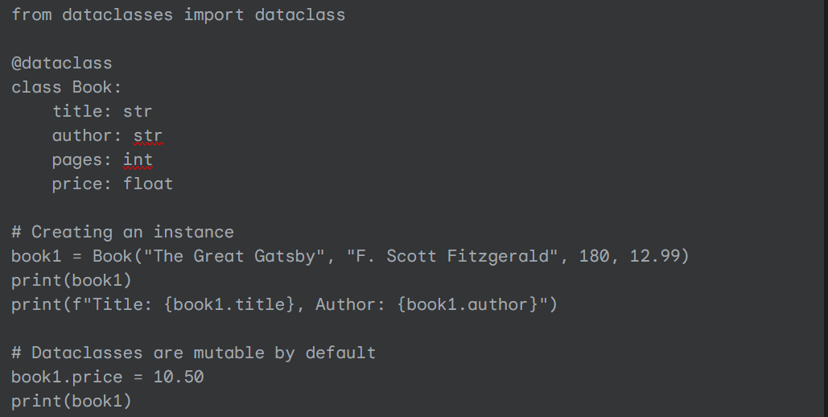
@dataclass
Official Code Link ➔ https://github.com/panaversity/learn-agentic-ai/tree/main/00_openai_agents/00_python_syntax
Code also saved in folder ➔ G:\osamabinadnan_files\giaic\quarter_04\OpenAI_SDK\OpenAISDK_Working_from_YTPlaylist\Video03_Divingin_sourcecodeof_OpenAIAgentsSDK

Slide 28
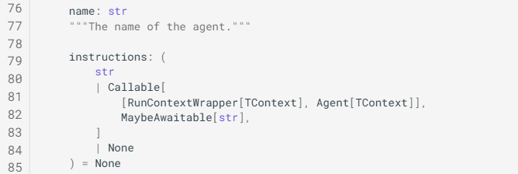
@dataclass
System Prompt vs user Prompt
https://openai.github.io/openai-agents-python/ref/agent/
Callable method

Slide 29
Understand behind the scene code of Runner
RSI ➔ Recursive self improvement, in future agent will improve itself by using it memory
run, run_sync and run_stream are class level static method which help to run flow of agents
Runner works on loop, which is called Agent loop
RunResultStreaming is also a @dataclass

Slide 30
Dataclass, Generics and Callable in Python to understand OpenAI Agents SDK Source Code
Dataclass (@dataclass)
A dataclass is a shortcut for creating classes that store data. It automatically creates things like the __init__ (constructor) and __repr__ (string representation) methods for you.Think of it like this:
Instead of writing a whole class just to store some variables, you can use @dataclass to make your code shorter and cleaner.

Slide 31
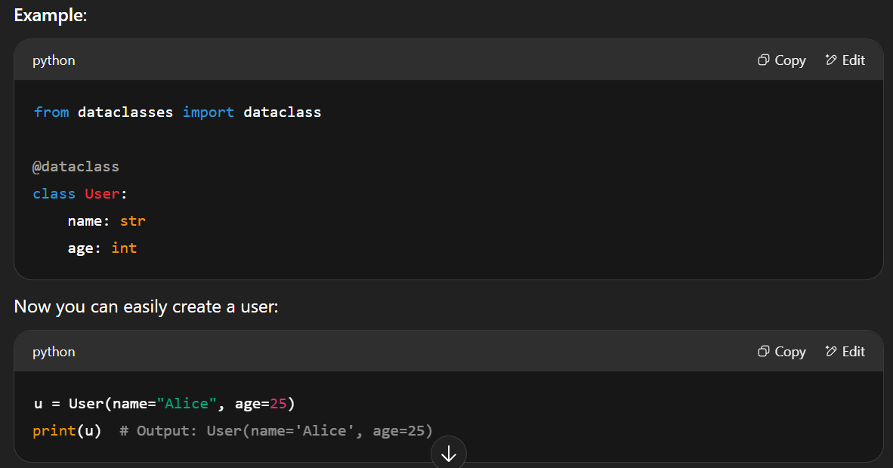
Dataclass, Generics and Callable in Python to understand OpenAI Agents SDK Source Code
Dataclass (@dataclass)

Slide 32
Dataclass, Generics and Callable in Python to understand OpenAI Agents SDK Source Code
Generics
Generics let you write code that can work with any type, without being specific about which one. It makes your code reusable and type-safe. Think of it like this:
You're saying, “I don't care what type it is yet — I’ll fill that in later.”

Slide 33
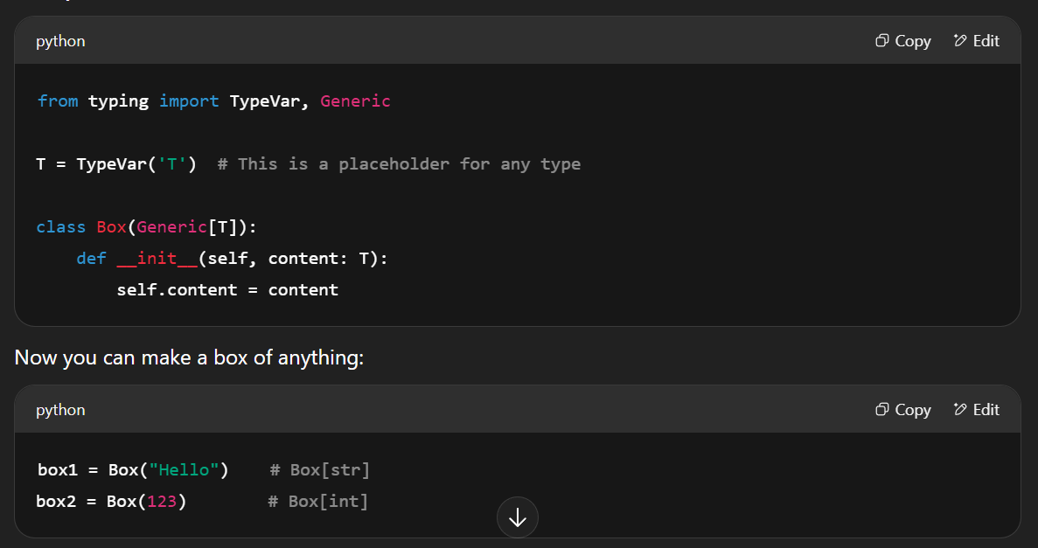
Dataclass, Generics and Callable in Python to understand OpenAI Agents SDK Source Code
Generics

Slide 34
Dataclass, Generics and Callable in Python to understand OpenAI Agents SDK Source Code
Callable
A Callable is just something you can call like a function. In Python, functions are callables, and so are objects with a __call__ method. Think of it like this:
If you can do something(), then something is a callable.

Slide 35
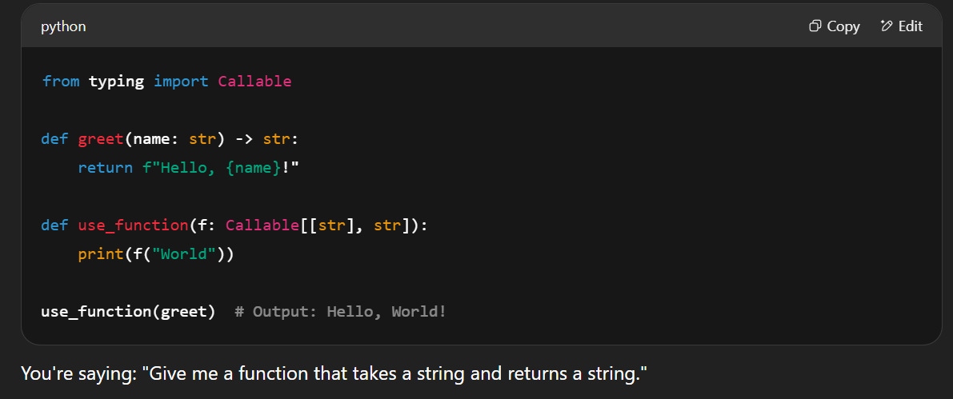
Dataclass, Generics and Callable in Python to understand OpenAI Agents SDK Source Code
Callable

Slide 36
Agent Loop | Tool Call | Hands off | Memory | Guardrails
Agent is nothing but LLM call
OpenAI brought ChatCompletionAPI first time
Then many companies made wrapper on OpenAI’s ChatCompletionAPI like LangChain, EasyLLM etc.
At the bottom is RestAPI ➔ on it ChatCompletion API (which adopted by most of the companies) to chat with LLM ➔ then Langchain
You just import openai library, change base url, instead to go to openai server, it will go somewhere else (on mentioned URL)
We can do handoff in LangGraph, AutoGen and in OpenAI Agent SDK as well. Best is OpenAI SDK

Slide 37
Agent Loop | Tool Call | Hands off | Memory | Guardrails
OpenAI Agent Core Concept
Story begin with LLMs, different companies made it, user asked AGI level questions to them
OpenAI made it standard at first place when it achieved AGI level
Whoever (Google, Meta etc.) achieved AGI wrote its SDK.
It means that they made package in python to talk with LLMs
Client (Your PC) ➔ send request to model’s server
Your PC send request to model server, the server response it and give you answer.

Slide 38
Agent Loop | Tool Call | Hands off | Memory | Guardrails
Earlier, this work you can do by making http request restAPI and talk to it
Then these companies made easy way to used LLMs which they called SDK.
You just need to install python package of SDK; implement it function and ask to your agent.
The functions of SDK, we can call it ChatCompletion, Assistant API, Responsive API etc.

Slide 39
Agent Loop | Tool Call | Hands off | Memory | Guardrails
A Good Software (OpenAI Agent SDK)
Good software will be made in layers, otherwise it becomes confusing, same is the case for OpenAI SDK
First layer is LLM, ➔ on which it wrap with wrapper for example FastAPI for inference ➔ then you call it from client using RestAPI, although we can call in any language but industry is going toward python then we are calling it in python
LLM ➔ API Server ➔ client (ChatCompletion API which is calling Rest) ➔ Agent SDK

Slide 40
Tool Call
Tool calling means that an AI agent (like ChatGPT) can use special tools (like a calculator, web search, or code runner) to help it solve problems or get answers.
Example:
Imagine an AI that can't do math very well in its head.
So, when you ask it: "What’s 37 x 82?", it says, “Let me use my calculator tool!”.
It calls a tool (the calculator), gets the answer, then replies to you.

Slide 41
Tool Call
Does LLMs have access of tools schemas, if yes, how it looks like and works??
Yes, LLMs (like ChatGPT or other AI agents) can have access to tools via what's called a tool schema (also called function schema, API schema, or OpenAPI spec). This tells the LLM what tools are available, how to use them, and what inputs/outputs they take.
What is a Tool Schema?
A tool schema is like a menu or instruction sheet that tells the LLM:
"Here is a tool you can use. This is what it does. Here’s how to use it.“
It's usually defined in JSON format, like this (see below picture):

Slide 42
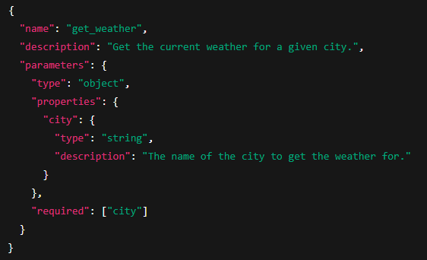
Tool Call

Slide 43
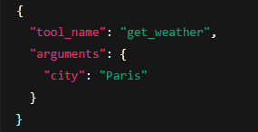
Tool Call
How Does the LLM Use It?
Reads the tool schema during setup or runtime.
When you ask something like:
"What’s the weather in Paris?", the LLM thinks:
“I have a tool called get_weather and it needs a city. Let me call it with city: 'Paris’.”
It generates this tool call: ➔

Slide 44
Tool Call
4. The system (not the LLM itself) executes the tool, gets the result (e.g., 22°C and sunny), and gives that back to the LLM.
5. The LLM then replies:
“It’s 22°C and sunny in Paris right now!”
Where Are These Schemas Used?
OpenAI Function Calling
LangChain Tools
AutoGPT / Agentic frameworks
Custom APIs in enterprise AI setups

Slide 45
Stateless Nature of the API
LLMs are stateless, it means it don’t have memory to recall last conversation until and unless you made it stateful.
To make stateful LLMs send all conversation in every request.
So, OpenAI made OpenAI SDK over ChatCompletionAPI (stateless layer), which remember all session. You don’t need to send all your previous conversion to it.

Slide 46
Agent Loop
An Agent Loop is when an AI agent (like ChatGPT acting like a smart assistant) keeps doing a cycle of:
Thinking 🧠
Taking action (like calling a tool) 🛠️
Observing the result 👀
Thinking again based on the new result...
Repeat 🔁
Until it reaches a final answer or goal ✅.
Thought → Action → Observation → [repeat until done]

Slide 47
Agent Loop
Agent has short term state, mean all conversation, so whatever task agent will do using tools, it will do by itself.
Lang chain and Autogen also were also doing the same
Agent Loop
System Prompt
User Request
Tool Calling
HandOff
Top Layer
Agent Loop (OpenAI SDK)
Second Layer
Chat Completion/Response API
First Layer
Rest API
Output
Modality (text/audio)
Action (Tool call)
Bottom Layer
LLM (Stateless)

Slide 48
Agent Loop / stateless LLMs
All tools/functions will be called within this loop and all will be done by using OpenAI SDK.
First thing is “Tools are called by Agent loop itself, depend on the user query.”
As we set LLMs have stateless protocol, so how can we make agents which don’t remember anything?
To resolve this problem, LLMs set that you can proceed 2 types of requests simultaneously, first is called system prompt other is user prompt.
So, the second thing is, “There are two types of prompts”

Slide 49
Agent Loop / stateless LLMs
System Prompt
A system prompt is like a set of instructions or rules given to the AI before it starts the conversation.
Example system prompt:
“You are a helpful and friendly assistant who speaks simply and clearly.”🧠
The agent reads this first and keeps it in mind throughout the chat.
User Prompt
A user prompt is what the user says or asks during the conversation.
Example user prompt:
“Can you explain how gravity works in simple terms?”
The AI uses both the system prompt and user prompt together to decide how to answer.

Slide 50
Agent Loop / stateless LLMs
Do you need to send the system prompt every time in Chat Completion API?
Yes, if you want the AI to remember the instructions.
The Chat Completion API does not store memory between requests. So:
If you want consistent behavior, you should include the system prompt in every request as the first message (with "role": "system").
Think of it like reminding the AI: “Here’s who you are again, and now here’s what the user wants.”
Third thing is, “function calling”
All these three things are abstract (hide) in OpenAI SDK.

Slide 51
Handoff
In the OpenAI SDK, especially in the context of multi-agent workflows or tool-using agents, a handoff means passing control or a task from one agent (or function/tool) to another based on logic or capability.
Handoff = When one agent (or function within an agent) decides it can't complete a task and delegates it — either to:
A human (human handoff),
Another AI agent (agent-to-agent handoff),
Or a tool/function (tool/function handoff).
Agent is the combination of system prompt, user prompt, tool description/calling.
Handoff is done in tool calling and handoff itself is a kind of tool calling but it abstraction is separate.

Slide 52
Handoff
The handoff and tool calling implementation are same from inside because same API is used in both.
There are 4 types of messages to understand loop, it’s all about talk between agent and LLMs
System Prompt/Instruction/Persona
User Prompt/Your Questions
Tool Message (process tool to give answer)
Assistant message/AI message/Agent Reply to user

Slide 53

Memory (Long term)
Memory Layer
Agent learn from interactions.
Toward RSI…
Long Term Memory Layer
Agent Loop
System Prompt
User Request
Tool Calling
HandOff
Top Layer
Agent Loop (OpenAI SDK)
Second Layer
Chat Completion/Response API
First Layer
Rest API
Output
Modality (text/audio)
Action (Tool call)
Bottom Layer
Memory layer also talk with LLM
LLM (Stateless)

Slide 54
Memory (Long term)
In the OpenAI Assistants / Agents system, "memory" means:
The ability for an agent to remember facts, preferences, or events from past conversations and use them in future interactions — like a human would.
This allows the agent to build context over time, not just within one conversation.
You can available memory in tool calling and in system prompt
Memory layer is also talk with LLM

Slide 55
Memory (Long term)
What is RSI in this context?
RSI = Retrieval System Interface
It’s a part of the architecture that supports memory by retrieving relevant past information (like user history, prior chats, facts) when the agent needs it.
✅ In simple terms:
RSI is the system that helps the agent "remember" things by retrieving stored information (from vector databases, notes, past interactions, etc.) and feeding it into the current conversation.

Slide 56
Memory (Long term)
How It Works (Simplified Flow):
User: "Remind me what I said about my favorite vacation spot?"
Agent uses RSI to search its memory store (e.g., vector DB or long-term notes).
It finds: “User said they love Bali in June.”
That info is inserted into the context or used to answer.
In memory, we will call LLM in order to reduced the usage of token and just get the context of previous conversations, not full conversation, it means memory will also used LLMs

Slide 57
Memory Management
Memory management is very important:
To memorize communication between agents
To remember work while agent performs individual task, keeping in short term or in long term memory
To remember what tool has done and remember it answer/reply
All these type of stuffs manage via memory layer and to manage this memory in efficient way, there is a package which we called LangMem

Slide 58
Work Flow of Agents
There is a certain difference between work flow and Agentic workflow
According to Anthropic design pattern article’s findings, agents and LLMs decide what will be the sequence of workflow through handoff and tool calling.
Article link ➔ https://www.anthropic.com/engineering/building-effective-agents
Workflow and agent could be of short term or long term, short term means one session, long term means keeping flowing and state

Slide 59
Work Flow of Agents
There are few implementation for long term memory till this lecture date.
Either you can used AWS step function
Or you can used AWS long running container
Or you can used LangGraph ➔ for medium
Or you can used Temporal services ➔ https://temporal.io

Slide 60
Guardrails
Guardrails are rules, filters, or controls that help keep AI agents safe, reliable, and on-topic during generation or decision-making.
They limit or guide what the AI can say or do, especially to:
Prevent harmful outputs
Enforce task boundaries
Stay within brand or domain rules
Improve trust and accuracy
Guardrails also talk with LLM.

Slide 61
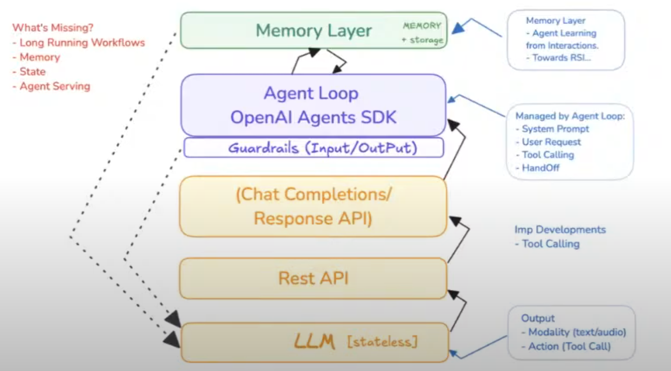
Guardrails

Slide 62
OpenAI SDK
OpenAI SDK provides everything except:
Memory layer
And little to no possibly to define long running workflows, it will be implemented by yourself using different external libraries.

Slide 63
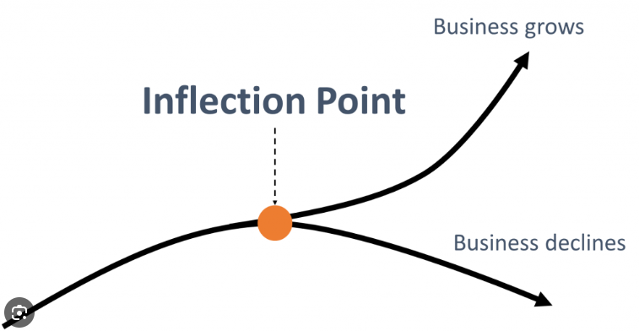
Inflection point
In business, Andy Grove, the former CEO of Intel, defined a strategic inflection point as a significant event that causes a major change in a company or industry, requiring a fundamental shift in strategy.
It's a turning point where the competitive environment changes, potentially leading to either significant growth or decline. Grove used the term to describe a moment where a company must adapt its approach or face obsolescence.

Slide 64
OpenAI SDK Discussion
In June 2023, openai introduced function calling and added in chat completion AI.
Microsoft’s Autogen made agent framework before their competitor and released version 0.2
There are 4 options to make agents
CrewAI: ➔ comparably easy but lack of logic. Crew ➔ agents ➔ tasks ➔ and crews itself in flows, debugging is very hard/complicated
LangGraph: ➔ hard to understand states, they mixed up 2 things, i.e., short term agentic (work) flow and long-term workflow.
AutoGen: Made decision to make agent once again with improve design and workflow which causes division in team so they apart their ways.
OpenAI SDK:

Slide 65
OpenAI SDK Discussion
To do analysis properly and in good way, write good prompt
Few LLMs are become more intelligent, ChatGPT 4.5, Gemini 2.0 pro, Grok 3.
OpenSDK ➔ 30% framework, 60% python, 10% external libraries for memory and other functionality.

Slide 66
Workflow vs Agents
Workflows (Procedural Execution Style)
A workflow is a predefined sequence of steps that the system follows to complete a task. It’s deterministic and modular.
Key Characteristics:
Static or semi-dynamic: Steps are known beforehand; the flow may include conditionals or branches, but the control logic is hard-coded or scripted.
Orchestrated: A controller (like a workflow engine or planner) explicitly decides the next step.
Predictable: Good for high-reliability, compliance, or constrained environments.
Task decomposition: Often uses subtasks and tool calls as modular, well-defined operations.

Slide 67
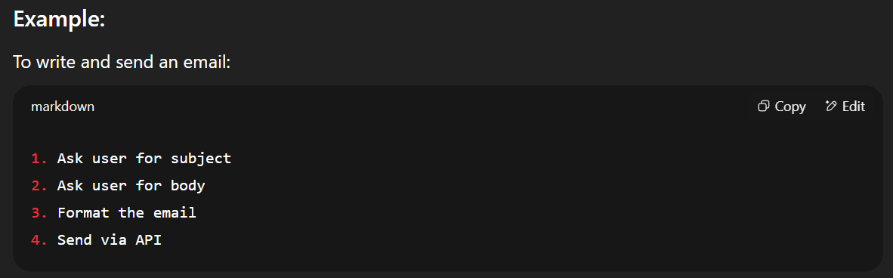
Workflow vs Agents
Workflow Example

Slide 68
Workflow vs Agents
Agents (Autonomous Execution Style)
An agent is an autonomous, goal-driven entity that uses reasoning to decide what to do next, possibly exploring and adapting dynamically.
Key Characteristics:
Dynamic planning: Agents choose the next action based on current state, tools, and goal.
Looping control: Agents often use think-act-observe cycles (e.g., ReAct or MRKL patterns).More autonomy: Agents decide how to complete the goal, not just follow steps.
Stateful: Agents remember intermediate states, outcomes, failures.
Emergent behavior: Sometimes solutions arise that weren't explicitly programmed.

Slide 69
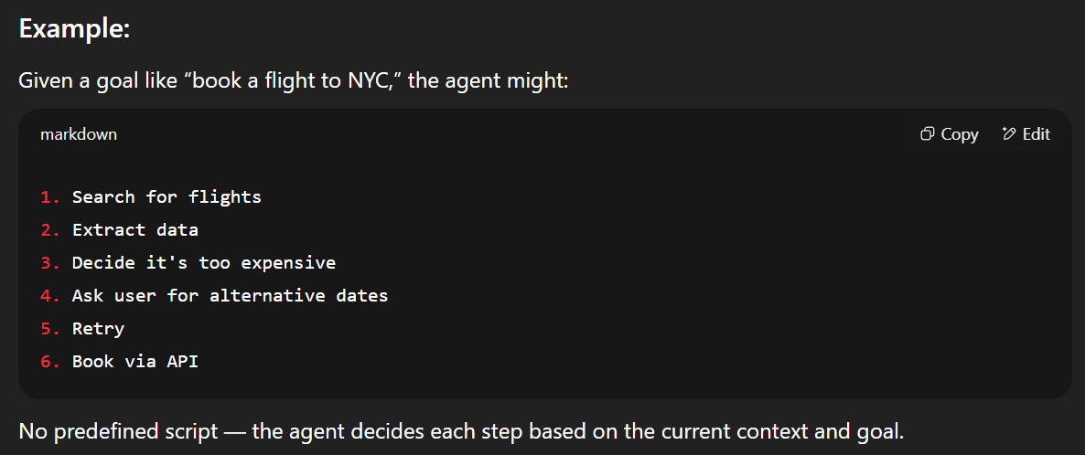
Workflow vs Agents
Example Agents (Autonomous Execution Style)

Slide 70
Short-Term Workflows vs Long-Term Workflows
Short-Term Workflows (Microplans)
Definition:
Templated sequences of steps to achieve subgoals within a single agent loop or session.
Characteristics:
Focused on immediate tasks (e.g., "summarize a document," "extract a table").
Often cached or retrieved from toolkits (e.g., function graphs).
Agent calls or instantiates them dynamically.
How Agents Use Them:
As building blocks to solve parts of larger goals.
Invoked when a known pattern matches the current subgoal.
Can be executed as-is, modified, or aborted mid-way.

Slide 71
Short-Term Workflows vs Long-Term Workflows
Long-Term Workflows (Macroplans)
Definition:
Extended, goal-level strategies or plans that span multiple steps, sessions, or time horizons.
Characteristics:
Represent high-level plans (e.g., “launch a product,” “plan a vacation”).
May persist across sessions or agent memory.
Include checkpoints, dependencies, and progress tracking.
How Agents Use Them:
As strategic scaffolding: guides the agent in sequencing major stages.
Enables resumability and temporal reasoning over days/weeks.
Often stored in vector memory, graph structures, or long-term state.

Slide 72
🧠 In Practice: Agent + Workflow Fusion
Agents don’t replace workflows — they use them:
Short-term workflows: Like calling a subroutine.
Long-term workflows: Like following a project plan.
The agent chooses when to execute them, how to adapt them, or whether to abandon them based on reasoning and observations.

Slide 73
Open AI SDK Discussion
OpenAI SDK:
Is not workflow but agent.
Does dynamic routing
Is short term
This make easy to use and you can use it for smaller single session task due to short term.

Slide 74
MCP (Model Context Protocol)
MCP (Model Context Protocol) is an emerging concept/protocol designed to enable coordination between large language models (LLMs), agentic systems, tools, and environments.
It’s most prominently associated with OpenAI’s research into AI agents, introduced around early 2024.
MCP is a high-level abstraction layer or interface that helps manage context, state, and communication in complex AI-agent architectures.

Slide 75
What is MCP (Model Context Protocol)?
MCP stands for Model Context Protocol. It is a communication and coordination protocol designed to:
Standardize the interaction between models and their environment (tools, memory, world states).
Allow agents to persist knowledge, state, and goals across steps or tasks.
Help orchestrate multiple agents or model instances working together, potentially asynchronously.
Support long-lived, autonomous agentic behaviors beyond single-turn prompts.
Think of it as a “software bus” or orchestration layer for agent-like systems using LLMs.

Slide 76
🔧 What does MCP do with Agents?
MCP is a key enabling infrastructure for building advanced AI agents, particularly those that:
Need memory (beyond what a single model context can hold).
Perform multi-step reasoning or planning.
Interact with multiple tools, APIs, or real-world systems.
Persist identity, goals, or context across time.
Coordinate multiple model instances (e.g., planner, executor, critic, etc.).
Concretely, MCP does things like:
Tracks agent state: Goals, plans, world model, memories, tasks in progress.
Manages context: So, the model can resume tasks with relevant context without reloading everything.
Routes messages: Between agents, tools, APIs, or humans.
Encapsulates prompts + metadata: Such as system message, tool responses, or user instructions.

Slide 77
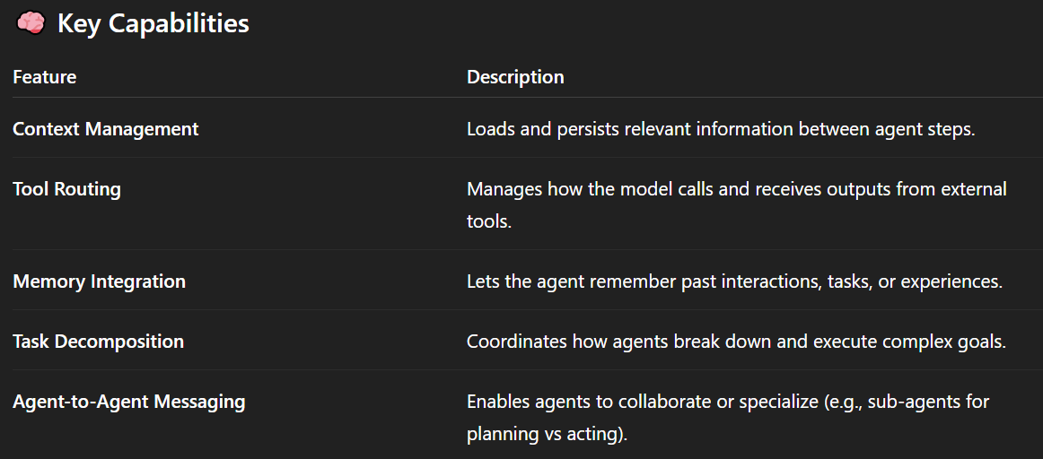
Key Capabilities

Slide 78
🧪 Example Use Case
Imagine an AI executive assistant that:
Remembers your calendar.
Plans a trip.
Books hotels, reschedules meetings.
Learns from feedback.
Coordinates with sub-agents (e.g., a flight booking agent, a budget optimizer).
MCP allows this assistant to maintain context over hours/days, route tasks to the right agents or tools, and operate autonomously without forgetting what it's doing between steps.

Slide 79
MCP Discussion
You can give external info to LLMs by below 3 ways:
You can train model on new data ➔ which is obviously a hard job
You can make RAG (Retrieval Augmented Generation) system, like convert all your document data into vector and place in vector database. RAG retrieves relevant external documents (usually stored in a vector database) and then uses them to generate more accurate and grounded responses.
You can used external data using tool/function calling, the hardest thing in function calling is to make schema of function, i.e., name, parameter, required parameters, what function does?, what response function will give after processing etc.
MCP found this (schema issue) gap, MCP hired 1100 sources so developer can connect them to get external info which is very hard tp do and time consuming.

Slide 80
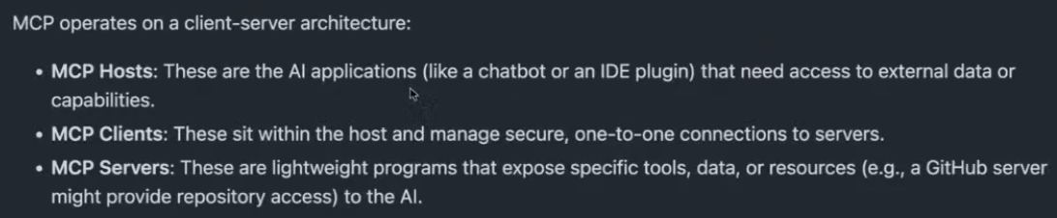
MCP Discussion
It was release in Dec 2024 and it is getting maturity day by day.
For those 1100 sources, developer had to write tools and schema, that is why MCP was released, a protocol in which all 1100 sources tools and schema has been written in standard way.
MCP operates on a client server architecture

Slide 81
Development to Deployment & Introduction to DACA Design Pattern
Discussion
If we created virtual machine, it’s obvious it is stateful (memory), but the problem is we can’t scale it up.
Cloud owners determined that the virtual machine is not as good respect to scalability and made it light weight version which is ‘containers’, containers are stateless.
You give request to container, container ups ➔ load state from database ➔ do your assign work ➔ it’s saved some stuff database ➔ Give response back to you ➔ then forget everything about you.
So, the design pattern which give you maximum scalability those are stateless containers of ‘Docker’. These are also called ‘Serverless Containers’

Slide 82
Development to Deployment & Introduction to DACA Design Pattern
Discussion
As of today, the latest state-of-the-art stuff of cloud are serverless container (managed) or stateless container.
OpenAI SDK has record of complete conversation, when you call it in stateless method then you can save all conversation in database by single call, by this you can make scalable agent how? Stateless protocol, you made stateless FastAPI server which is inside container, when the request comes, it pick detail from database
To make applications, we have to merge cloud native technology and agentic AI, by merging these we can even make systems of Microsoft level.

Slide 83
Development to Deployment & Introduction to DACA Design Pattern
Discussion
When we try to make our system serverless then it core root in Docker, we make microservices from docker and to manage these microservices (containers) using Kubernetes.
Kubernetes auto manage containers, if million, billion users come to your app, it will up million billion containers/microservices
Although, Kubernetes is very hard to learn and we have to make serverless system, so we will learn Docker (as a base for serverless) and DAPR.

Slide 84
DACA (Dapr Agentic Cloud Ascent)
Dapr Agentic Cloud Ascent (DACA) is a design pattern for building and scaling agentic AI systems using a minimalist, cloud-first approach. It integrates the OpenAI Agents SDK for agent logic, MCP for tool calling, Dapr for distributed resilience, and a staged deployment pipeline that ascends from local development to planetary-scale production. DACA emphasizes:
AI-First Agentic Design: Autonomous AI agents, powered by the OpenAI Agents SDK, perceive, decide, and act, with MCP enabling tool access and A2A facilitating intelligent agent-to-agent dialogues.
Agent-Native Cloud Scalability: Stateless containers deploy on cloud platforms (e.g., Azure Container Apps, Kubernetes), leveraging managed services optimized for agent interactions.
Stateless Design: Containers that scale efficiently without retaining state.
Dapr Sidecar: Provides state management, messaging, and workflows.
Cloud-Free Tiers: Leverages free services for cost efficiency.
Progressive Scaling: From local dev to Kubernetes with self-hosted LLMs.

Slide 85
DACA (Dapr Agentic Cloud Ascent)
Discussion:
Cloud Ascent refers to the process of developing an application locally—such as on a laptop during the development phase—and seamlessly scaling it to support millions of users in the cloud as demand grows.
And this cloud is for agents
Is DACA is framework or design?? Check appendix III in below link
https://github.com/panaversity/learn-agentic-ai/blob/01e344ba85ec36134c783b5ceef45a12a9bb7e68/comprehensive_guide_daca.md#appendix-iii-daca-a-design-patter-or-framework

Slide 86
DACA (Dapr Agentic Cloud Ascent)
Discussion:
The Dapr Agentic Cloud Ascent (DACA) is best classified as a design pattern, though it has elements that might make it feel framework-like in certain contexts. Let’s break this down to clarify its nature and why it fits the design pattern label, while also addressing the nuances that might lead to confusion.
Framework: A reusable, pre-written set of code or libraries that provides a structure for developing applications. It often dictates the flow (e.g., React, Django).
Design Pattern: A general, reusable solution to a common software design problem. It's a conceptual template, not actual code (e.g., Singleton, Observer).
In short: Framework = implementation + structure. Design Pattern = conceptual solution

Slide 87
DACA (Dapr Agentic Cloud Ascent)
Discussion:
In DACA, we are using DAPR (DAPR is tech which is used to distribute microservices which communicate with each other), Agents (any tech used to make agents) and Cloud (any tech for cloud native)
DACA as a Pattern: It’s a high-level strategy for agentic AI systems, focusing on architecture (three-tier, EDA), principles (statelessness, HITL), and deployment stages (local to planet-scale). It doesn’t provide a runtime or library—you build the system following its guidance.
Not a Framework: DACA doesn’t offer a pre-built runtime, APIs, or enforced conventions. While it suggests tools (e.g., Dapr, FastAPI), these are optional, and the pattern’s core is about how to structure the system, not what to use.

Slide 88
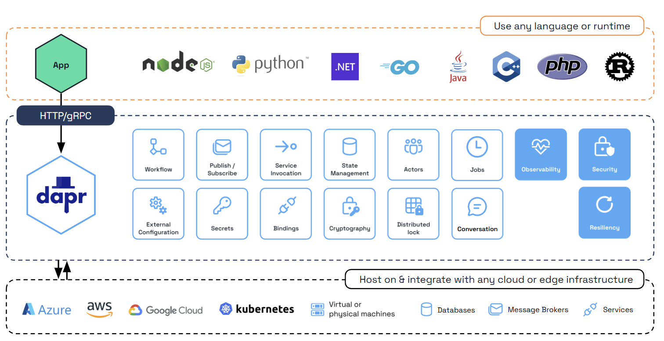
DACA (Dapr Agentic Cloud Ascent)
Discussion:

Slide 89
DACA (Dapr Agentic Cloud Ascent)
Discussion:
DAPR is an open source, you can call it framework, tool or library which we can used using Python, Node, and other languages mentioned in above picture
You make your software in chuck and each chunk in distributed in microservices, you are continuously adding feature as a separate microservice
DAPR is responsible for communication between these microservices

Slide 90
DACA (Dapr Agentic Cloud Ascent)
Discussion:
DAPR up container in stateless position, it means you up container in which live streaming feature is uploaded but different users are streaming at the same time but state will come from user’s system, which user will use streaming microservices suppose on Facebook.
Think of your container as a "bike" running your microservice. DAPR acts as a "sidecar," providing additional features. For example, if your container fails, DAPR automatically starts another container to ensure the task is completed.

Slide 91
DACA (Dapr Agentic Cloud Ascent)
Discussion:
You can deploy it on any cloud where Kubernetes are present
Kubernetes in orchestrator which up and down the container when event comes
For tool calling, we will use new version of MCP which is remote and will be running in some container.

Slide 92
Agent to Agent Communication & Development, Protoyping, Production using DACA
Discussion:
Imagine a world where everything is an AI agent, from your coffee machine to your car, from businesses to entire cities. Picture a world transformed into Agentia—a dynamic, living network of intelligent AI agents seamlessly integrated into our daily lives.
From our homes and offices to entire cities, systems no longer communicate through outdated APIs but through sophisticated, intelligent dialogues driven by state-of-the-art AI frameworks.
Agentia scales effortlessly across the globe, thanks to its foundation in cloud-native technologies. Agentia is more than digital—it's also physical, brought to life by robots that serve as embodied agents interacting with and enhancing our physical world.

Slide 93
Agent to Agent Communication & Development, Protoyping, Production using DACA
Discussion:
Google launched A2A with collaboration with other companies in April 2025.
A2A, launched by Google with over 50 partners, is integral to DACA. It uses HTTP, SSE, and JSON-RPC to enable secure, modality-agnostic (text, audio, video) agent communication. Key A2A features in DACA include:
Agent Cards: JSON files (/.well-known/agent.json) advertise capabilities, enabling discovery.
Task Management: Agents initiate and process tasks with real-time feedback via A2A endpoints.
Interoperability: Connects agents across platforms, supporting Agentia’s vision of a global network.
Security: Enterprise-grade authentication ensures trust in cross-domain dialogues.

Slide 94
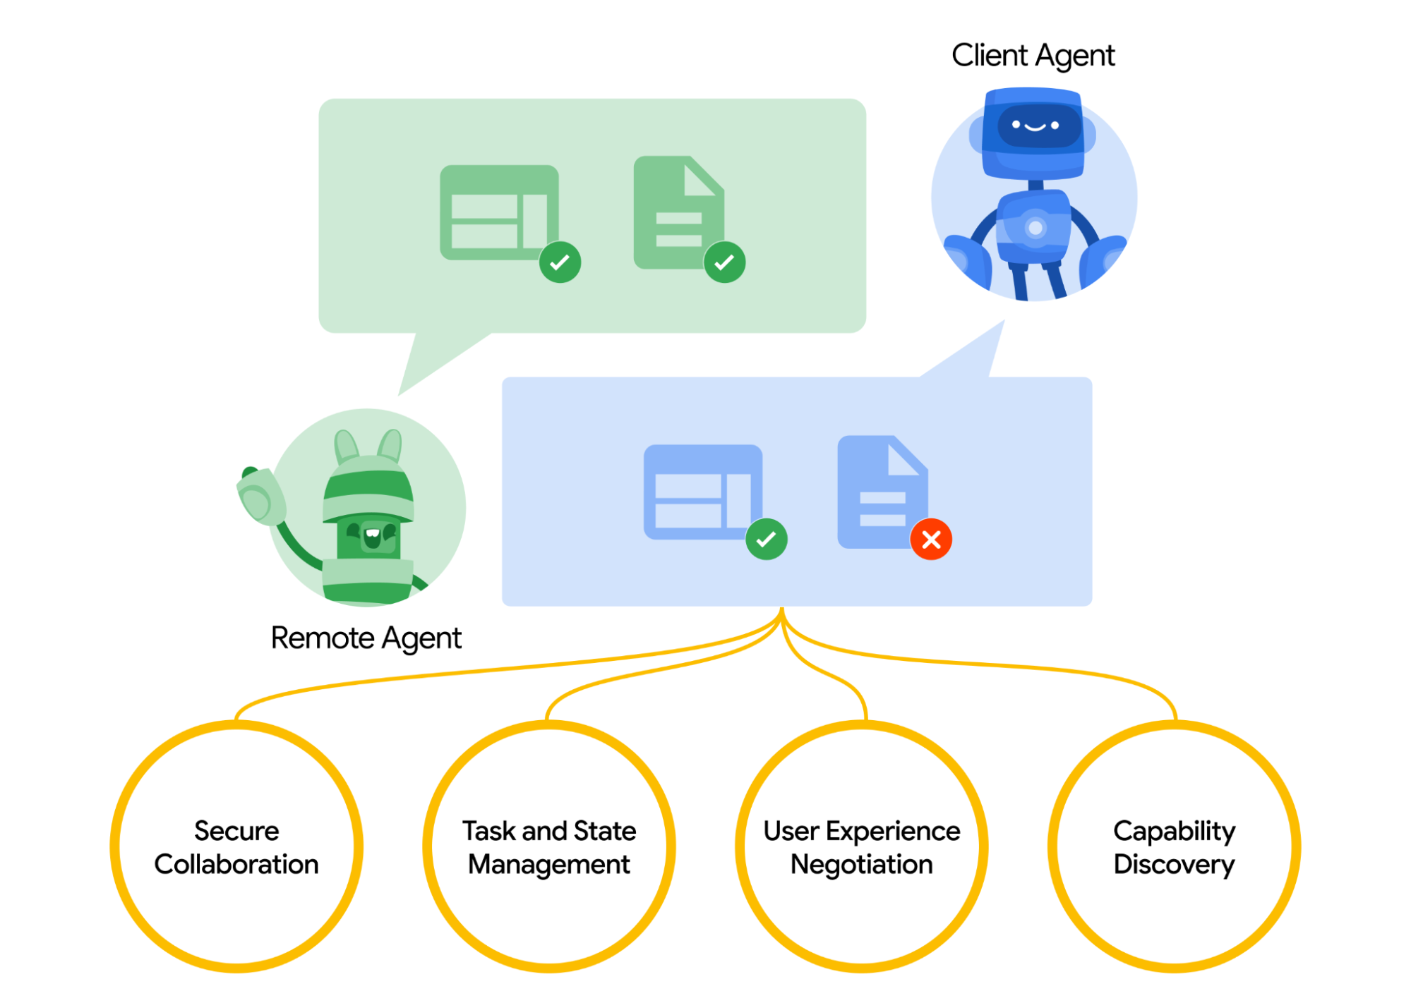
Agent to Agent Communication & Development, Protoyping, Production using DACA
Discussion:

Slide 95
Agent to Agent Communication & Development, Protoyping, Production using DACA
Discussion:
A2A (Agent-to-Agent) lets two agents work together — a client agent and a remote agent. The client agent sends tasks, and the remote agent carries them out to give back results or take action.
Here’s how it works:
Finding the right agent (Capability discovery): Each agent has a digital “Agent Card” listing its skills. The client agent uses this to pick the best remote agent for the job.
Handling tasks (Task management): Tasks can be short or long. For longer ones, the agents keep talking to stay in sync. The final result of a task is called an artifact.
Working together (Collaboration): The agents send messages to share info, progress, and instructions.
Adapting for the user (User experience negotiation): Messages include content like images, videos, or forms. The agents agree on the right format depending on what the user’s system supports.

Slide 96
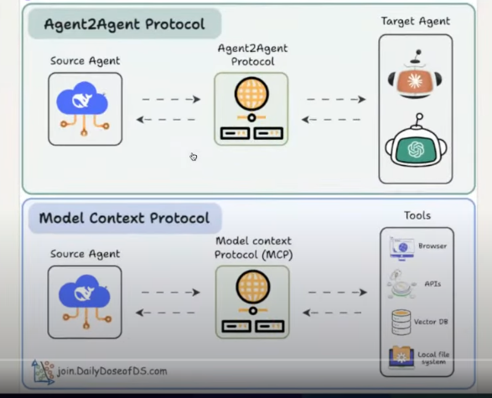
Why we need A2A when we already have MCP?
Discussion:

Slide 97
Why we need A2A when we already have MCP?
Discussion:
In the context of MCP, agents are provided with tools rather than being required to develop new ones. These tools can be pre-existing and are deployed to the MCP server for use by agents. In this model, agents are exposed through the MCP server and made available as callable resources.
Regarding A2A (Agent-to-Agent) communication within MCP, there is a single supported interaction pattern: one agent utilizes another agent as a tool. This implies that agent-to-agent communication in MCP is unidirectional and hierarchical — one agent acts as the client, while the other functions as a tool or service provider. Therefore, any scenario involving A2A communication through MCP is structured such that one agent is effectively embedded into the workflow of another.

Slide 98
Why we need A2A when we already have MCP?
Discussion:
In the context of A2A (Agent-to-Agent) communication, the framework offers the flexibility to build truly dynamic and scalable multi-agent systems. Unlike traditional tool-based interactions, A2A enables agents to operate with a higher degree of autonomy.
Agents are not limited to functioning solely as tools for other agents. Instead, they are capable of self-discovery, allowing one agent to identify and connect with other agents at runtime. Through capability sharing mechanisms—such as the exchange of structured "Agent Cards"—agents can evaluate the skills and functionalities of others and determine the most appropriate collaboration path. This fosters a decentralized, intelligent environment where agents can initiate communication, delegate tasks, and cooperate seamlessly based on real-time needs and capabilities.

Slide 99
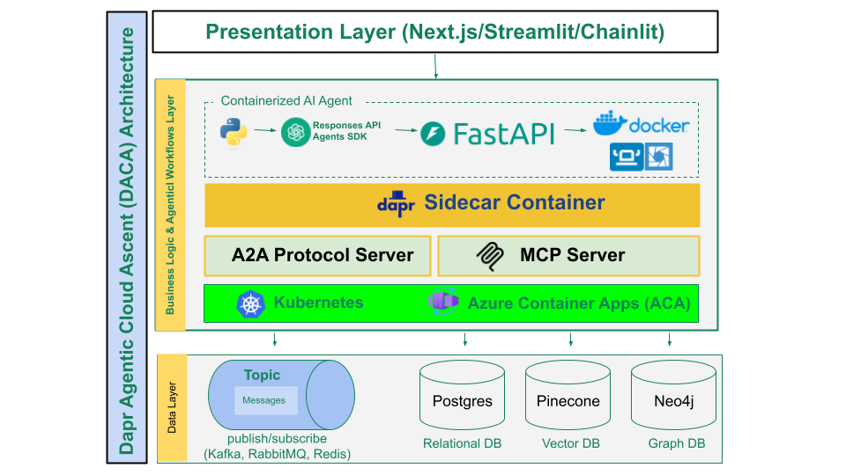
DACA Architecture Diagram Breakdown
Discussion:

Slide 100

DACA Architecture Diagram Breakdown
Discussion:
We use Python and the OpenAI SDK to build our agentic system. To interface with other systems or users, we expose the agent through an API framework—specifically, FastAPI.
In simple terms, the agent is wrapped with an API to make it accessible externally. This agent runs in the cloud, and as discussed previously, containerization is the ideal approach for cloud deployment.
Using Docker, we create a containerized environment that includes everything—from Python and the OpenAI SDK to FastAPI—ensuring consistency across local and cloud environments. This setup allows us to deploy the agent on any cloud platform with ease.
This whole process is called Containerized AI Agent.

Slide 101
DACA Architecture Diagram Breakdown
Discussion:
DACA Architecture is also called 3 tiers architecture
First layer is ‘Presentation layer’
Second layer is ‘Business Logic layer’
Third layer is called ‘Data layer’
DACA built on 3 tiers application
Presentation layer could be of nextjs, streamlit, chainlit or any other mock server from FastAPI etc.
To write business logic layer, we learn Python programming, OpenAI SDK, and learn FastAPI to expose agent as a web server or API

Slide 102
DACA Architecture Diagram Breakdown
Discussion:
Sidecar container (DAPR) used to communicate between microservices
Sidecar is responsible to make stateful your stateless microservice which is up due to some user interaction.
If microservice fail to up then sidecar has info about task who need to be done so it will up another microservice for it. That is called Resilience/Fault tolerance.
As its name shows, sidecar is supporting microservices i.e., to make microservice stateful, communication between microservices, keep it resilience, manage logs etc.

Slide 103
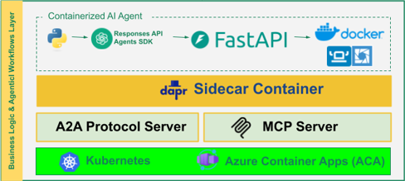
DACA Architecture Diagram Breakdown
Discussion:
If agent in FastAPI want to talk with another agent it will used A2A protocol and if agent want to talk with tools like Database, API then it will used MCP protocol.

Slide 104
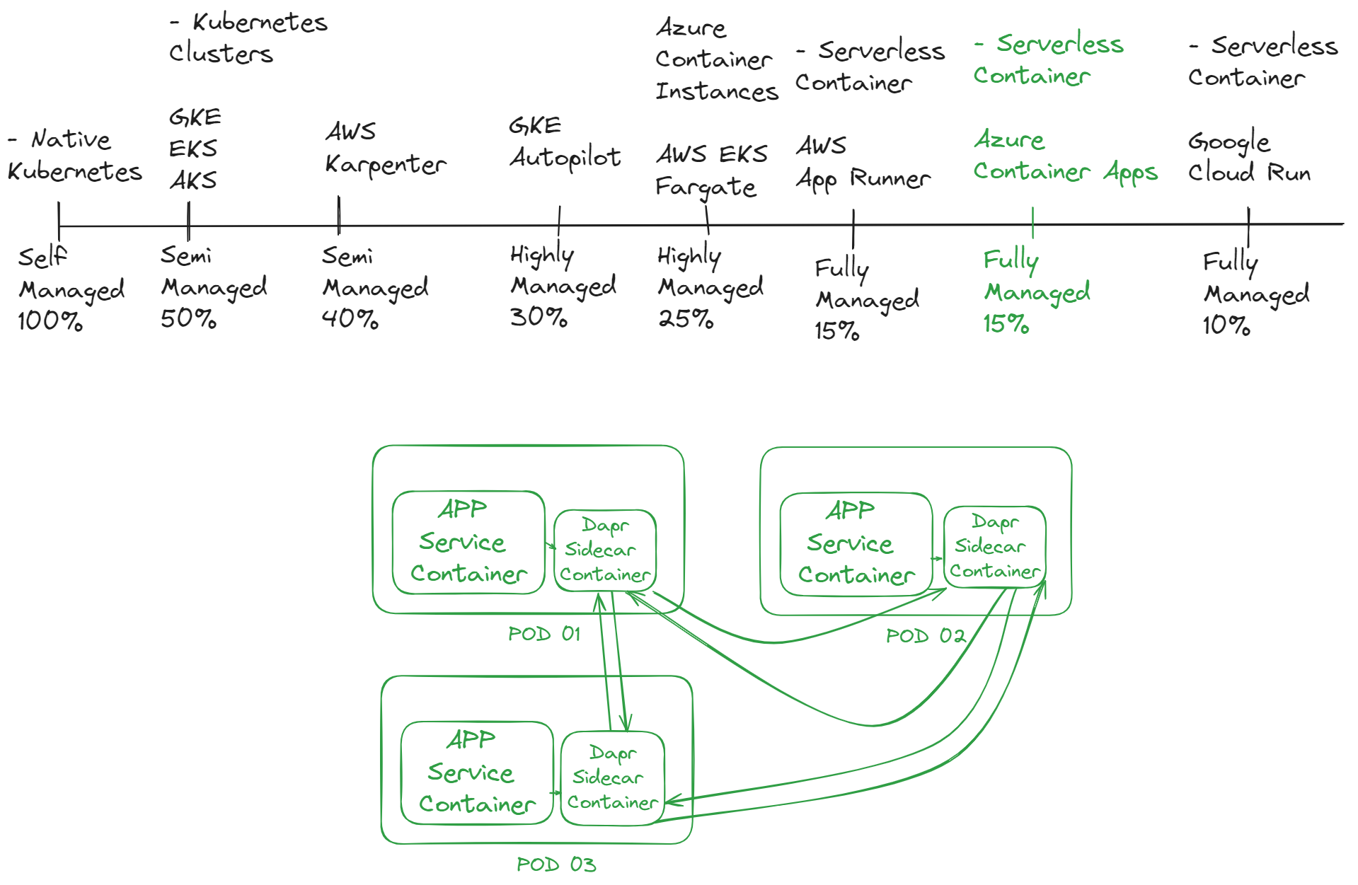
DACA Architecture Diagram Breakdown
Discussion:
Now we have Kubernetes and Azure layer (check video from 55 min to 1.23 hr)

Slide 105
DACA Architecture Diagram Breakdown
Discussion:
Python code is running in container (logical visualization / logical separate boundary), why we have to run python code in container? It has 2 reasons
Our native should run, native means refers to applications or services specifically designed and built to run in a cloud environment, leveraging its full capabilities such as scalability, elasticity, distributed architecture, and managed services. These apps are not just migrated to the cloud—they are optimized for it from the ground up.
If we want to orchestrate/manage something with Kubernetes that it is the requirement of it to run your code in container, otherwise Kubernetes will not manage your code.

Slide 106
DACA Architecture Diagram Breakdown
Discussion:
Container also has few requirement like
Network connection to connect with it
Container needs hardware i.e., CPU, storage, RAM etc.
Kubernetes also make logical network service and named as POD; the aim of this POD is to run container. Kubernetes is a big system, in Kubernetes POD is responsible for running container because POD provides:
Network to container
Address to container
Spec (hardware, RAM, CPU, storage)

Slide 107
DACA Architecture Diagram Breakdown
Discussion:
But in highly scalable system, there is problem if 20 millions users landed on my app if one POD enough for me?
Suppose as per given scenario I increase the quantity of containers, but how Kubernetes will know that I increase containers to suppose 5?
First of all, Increasing and decreasing of container is in Kubernetes domain, not us, it doesn’t directly manage container but POD on the behalf of Kubernetes controls containers.
If 20 million traffic come to your app then Kubernetes increases PODs (containers are inside the PODs)

Slide 108
DACA Architecture Diagram Breakdown
Discussion:
If users decline on your app, then Kubernetes also scale down no of PODs in order to save resources
As developers, when we build highly scalable systems, our Python code often needs to interact with external components like databases or state management services.
While Kubernetes can understand the resource requirements of the Python application and allocate them accordingly, a question arises: how does Kubernetes know that the Python code is making calls to external systems, such as databases? How does it detect these interactions, and how does it manage or track accountability for these external calls?

Slide 109
DACA Architecture Diagram Breakdown
Discussion:
If Kubernetes were to track accountability, how could it help reduce redundancy—for example, when five containers running the same code are all making identical calls to the database?
Sir Aleem suggested a plug-and-play approach. This means when deploying a container, although POD is providing resources (hardware, RAM etc.) we should inform the Pod about the necessary external dependencies—such as which database to connect to, which storage to use, and which APIs to call.
However, the Pod's responsibility is limited to managing the container and its lifecycle; it doesn’t handle external integrations. This is where Dapr (Distributed Application Runtime) comes in. Dapr acts as a sidecar to the application, handling service calls, state management, pub/sub, and more—enabling a clean, modular, and reusable approach to external system interaction.

Slide 110
DACA Architecture Diagram Breakdown
Discussion:
The term "sidecar" in this context refers to running an additional container alongside the main application container within the same Pod.
This sidecar container acts as a supporting service that helps the main application manage external interactions—such as connecting to databases, handling state, or making API calls.
In the case of Dapr, it runs as a sidecar container. While your main code container focuses on business logic, Dapr handles the communication with external systems but we have to inform Dapr to connect with which resource.
This separation of concerns allows for a more modular, scalable, and reusable system design.

Slide 111
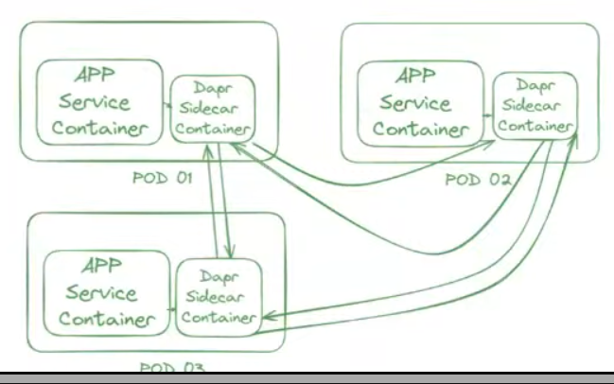
DACA Architecture Diagram Breakdown
Discussion:

Slide 112
DACA Deployment Stages: The Ascent
1. Local Development: Open-Source Stack (Discussion:)
Github link for detail ➔ https://github.com/panaversity/learn-agentic-ai/blob/main/comprehensive_guide_daca.md#daca-deployment-stages-the-ascent
We should make container which will run on local development, hugging face, azure container app and on Kubernetes, only the configuration of code is different but code remain same when running on different platforms.
Goal: Rapid iteration with production-like features.

Slide 113
DACA Deployment Stages: The Ascent
1. Local Development: Open-Source Stack (Discussion:)
Now what can we do? Your container is running in which you have your FastAPI and agent code, same as you have another container having both are running, both container communicating with each other using Dapr and in between Rapid MQ as well, then you need database as well, considering these scenarios, you have 2 ways for local development.
Docker compose: Run the agent app, Dapr sidecar, A2A endpoints and local services (Old suggestion – Apr 2025)
Rancher Desktop with Lens: Runs the agent app, Dapr sidecar, A2A endpoints and local services on local Kubernetes. (Newly sugguested – July 2025)

Slide 114
DACA Deployment Stages: The Ascent
2. Prototyping: Free Deployment (Discussion:)
For prototyping, like to show your work to customer or friend and for testing, you need free deployment service, go to Hugging face docker spaces.
Hugging Face Spaces offers the ability to host custom applications using Docker containers, known as Docker Spaces. This feature allows users to deploy machine learning demos and applications that go beyond the capabilities of the default Streamlit and Gradio SDKs provided by Hugging Face.
https://huggingface.co/docs/hub/en/spaces-sdks-docker

Slide 115
DACA Deployment Stages: The Ascent
2. Prototyping: Free Deployment (Discussion:)
Hugging face docker space in completely (as of date), you can deploy as many as containers in it.
In hugging face docker space, container can handle up to 100 users.
On free tier, you can 2 CPUs and 8 to 16 GB ram. By spending 0.03 USD per hour, you can get 8 CPUs and 32 GB ram but it is for the situation when customer wants it to show their consumers.
For this you need cron-job as well, a CronJob in Kubernetes is a way to run a scheduled task (a job) at a specific time or interval — similar to the Linux cron system.
A CronJob is used to automatically run a container at a scheduled time, such as:
Every hour
Every day at midnight
Every Monday at 8 AM

Slide 116
DACA Deployment Stages: The Ascent
2. Prototyping: Free Deployment (Discussion:)
Goal: Test and validate with minimal cost.
Setup:
Containers: Deploy to Hugging Face Docker Spaces (free hosting, CI/CD). Both FastAPI, MCP Server, and A2A endpoints in containers.
LLM APIs: Google Gemini (free tier), Responses API.
Messaging: CloudAMQP RabbitMQ (free tier: 1M messages/month, 20 connections).
Scheduling: https://cron-job.org (free online scheduler).
Database: CockroachDB Serverless (free tier: 10 GiB, 50M RU/month).
In-Memory Store: Upstash Redis (free tier: 10,000 commands/day, 256 MB).
Dapr: Use Managed Dapr Service Catalyst by Diagrid free-tier.
Scalability: Limited by free tiers (10s-100s of users, 5-20 req/s).
Cost: Fully free, but watch free tier limits (e.g., Upstash’s 7 req/min cap).

Slide 117
DACA Deployment Stages: The Ascent
3. Medium Enterprise Scale: Azure Container Apps (ACA) (Discussion:)
Suppose customer said, there will be 1000 users landed on my app simultaneously, that will fall in medium enterprise scale
Goal: Scale to thousands of users with cost efficiency.
Setup:
Containers: Deploy containers (FastAPI and MCP Servers) to ACA with Dapr support (via KEDA).
Scaling: ACA’s free tier (180,000 vCPU-s, 360,000 GiB-s/month) supports ~1-2 always-on containers, auto-scales on HTTP traffic or KEDA triggers.
LLM APIs: OpenAI Chat Completion, Responses API.
Messaging: CloudAMQP RabbitMQ (paid tier if needed).
Scheduling: ACA Jobs for scheduled tasks.
Database: CockroachDB Serverless (scale to paid tier if needed).
In-Memory Store: Upstash Redis (scale to paid tier if needed).
Scalability: Thousands of users (e.g., 10,000 req/min), capped by OpenAI API limits (10,000 RPM = 166 req/s). Using Google Gemini will more economical.
Cost: Free tier covers light traffic; paid tier ~$0.02/vCPU-s beyond that.

Slide 118
DACA Deployment Stages: The Ascent
4. Planet-Scale: Kubernetes with Self-Hosted LLMs (Discussion:)
Goal: Achieve planetary scale with no API limits.
Setup:
Containers: Kubernetes cluster (e.g., on Oracle Cloud’s free VMs: 2 AMD VMs or 4 Arm VMs). Both FastAPIs and MCP containers.
LLM APIs: Self-hosted LLMs (e.g., LLaMA, Mistral) with OpenAI-compatible APIs (via vLLM or llama.cpp).
Messaging: Kafka on Kubernetes (high-throughput, multi-broker).
Scheduling: Kubernetes CronJobs.
Database: Postgres on Kubernetes.
In-Memory Store: Redis on Kubernetes.
Dapr: Deployed on Kubernetes for cluster-wide resilience.
Training: Use Oracle Cloud’s free tier to train devs on Kubernetes DevOps, ensuring skills for any cloud (AWS, GCP, Azure).
Scalability: Millions of users (e.g., 10,000 req/s on 10 nodes with GPUs), limited by cluster size.
Cost: Compute-focused ($1-2/hour/node), no API fees.

Slide 119
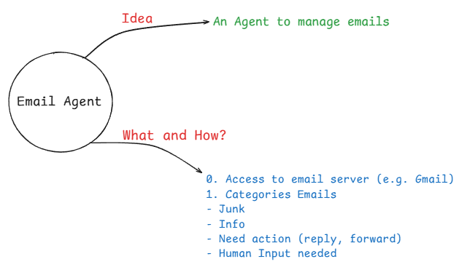
Conceptualizing an Email Agent: Our Mind Map Brainstorm
Discussion:
Mind mapping for email agent
We have to mind mapping email agent before execution, like my agent will be categorizing email in 3 or 4 categories i.e., important, less important, junk etc.

Slide 120
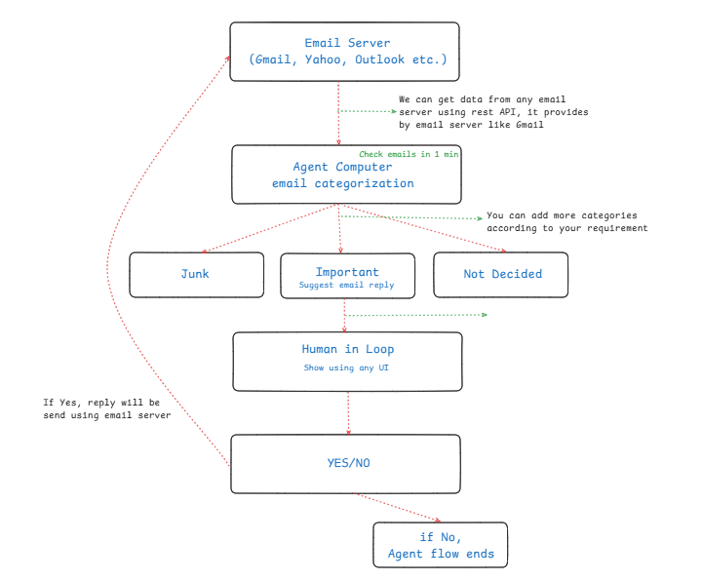
Conceptualizing an Email Agent: Our Mind Map Brainstorm
Discussion:

Slide 121
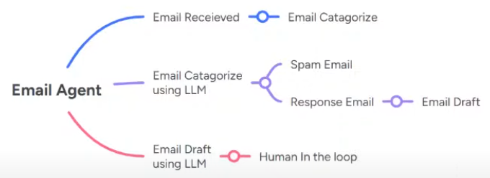
Conceptualizing an Email Agent: Our Mind Map Brainstorm
Discussion:
Above flowchart is just an example of email agent, we can improve it and can add new features.
Same is the case for below diagram

Slide 122
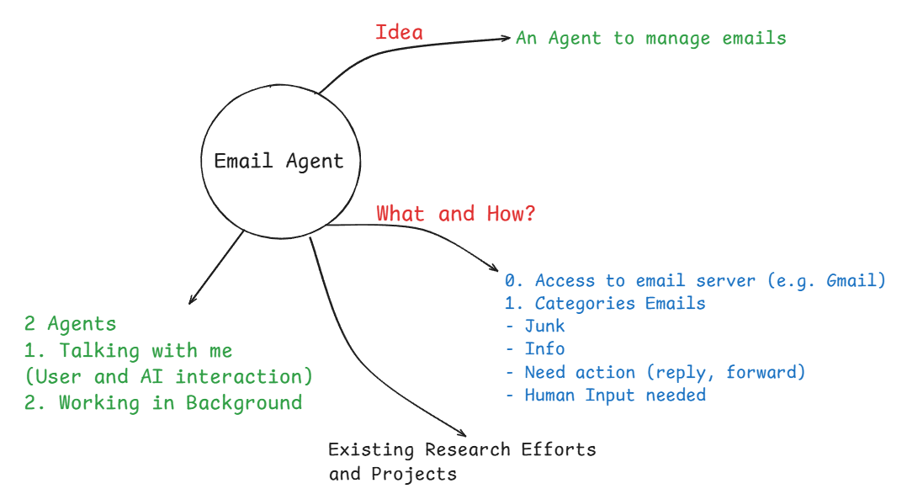
Conceptualizing an Email Agent: Our Mind Map Brainstorm
Discussion (cont.):
There is a difference between ERD (Entity Relationship diagram) and mind mapping, ERD is unstructured and use to define database schema.
Sir Zia suggested that there could be 2 agents, one is for user and agent interaction and other will be working in background.

Slide 123
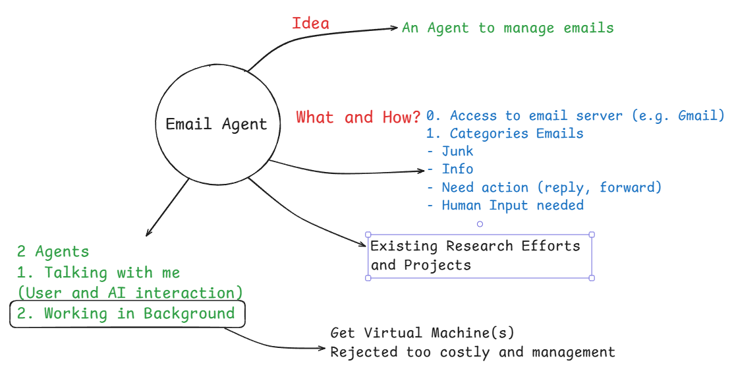
Conceptualizing an Email Agent: Our Mind Map Brainstorm
Discussion (cont.):
But the question is, how will you implement and manage background agent which is running autonomously? You should think about cloud point of view, it is easy to implement it on your machine because of less users and when internet or your machine close, agent will stop working.
You get virtual machine from amazon or some other provider but it may get error or any other technical issue then it will be close/not work, this idea is rejected

Slide 124
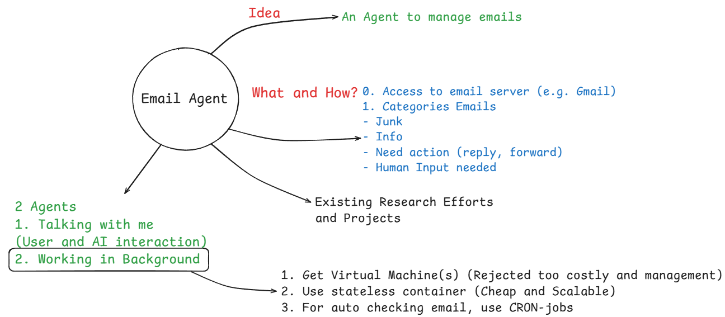
Conceptualizing an Email Agent: Our Mind Map Brainstorm
Discussion (cont.):
Now a days, everyone using is stateless container, so we will used the same in this case
If we used container then we have to make sure when will agent take detail from email server because although stateless server are cheap but it incurred some cost when container is up.
2 types of stateless container 1) User Event based 2) Schedule Event based, which are called CRON-jobs.
CRON-jobs helps to trigger event

Slide 125
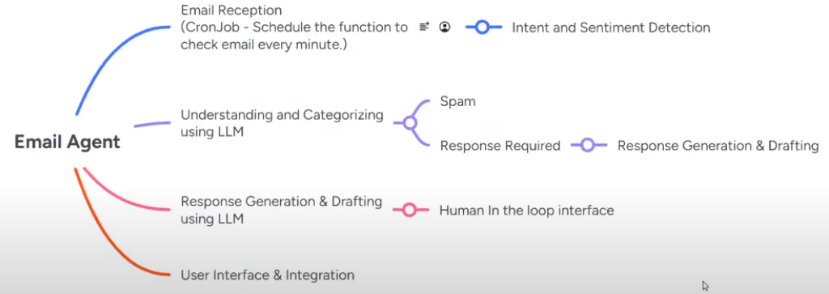
Conceptualizing an Email Agent: Our Mind Map Brainstorm
Discussion (cont.) Sir Ameen Take:

Slide 126
Conceptualizing an Email Agent: Our Mind Map Brainstorm
Discussion (cont.) Sir Qasim take on it:
We work on 3 tier application architecture
On first layer, we make user interface
On second layer, we write business logic like where it will run?
On last layer, we have data layer
Whatever API you used like OpenAI, Gemini etc. they all give you plan of pay as you go, it means you only pay for resources which you used. This is possible due to serverless container/stateless container.
If you want to run code 24x7, it will incur some cost, we want to make such systems when user come and assign task to our server (using UI) then small machine or computer on/up, process user request and give back answer, then it off/down the machine/computer

Slide 127
Conceptualizing an Email Agent: Our Mind Map Brainstorm
Discussion (cont.) Sir Qasim take on it:
When request receive it should be on/up, as soon as response delivered, it should be off/down.
If this functionality you can apply on your computer or server, that is called serverless computing.
Serverless computing because of ‘microservices architecture plus container’.
Request received ➔ computer on/up ➔ data which user want us to process is in some data layer ➔ process that data ➔ give response to user ➔ simultaneously save that data in data layer ➔ computer off/down again

Slide 128
Conceptualizing an Email Agent: Our Mind Map Brainstorm
Discussion (cont.) Sir Qasim take on it:
This is how serverless container works, by using this logic scalability is possible in today’s world doesn’t matter million or billion users comes to your app.
This serverless computing (EDA ➔ Event Driven Architecture) will possible due to DAPR, which we will discuss later.

Slide 129
Conceptualizing an Email Agent: Our Mind Map Brainstorm
Discussion (cont.):
For asynchronous communication, we used Kafka, Rabbit MQ, Redis Streams etc. these all are message broker software.
For synchronous communication, we will used RestAPI.
In a scalable system, we use something called a Load Balancer. This sits at the top of the system and handles all user requests.
When a user sends a request, it first goes to the load balancer. The load balancer checks which server (or container) has space. Then, it sends the user to that container.
If a container stops working (crashes or shuts down), the load balancer will move the user to another working container.

Slide 130
Conceptualizing an Email Agent: Our Mind Map Brainstorm
Discussion (cont.):
But what happens to the user’s data when the container crashes?
Here’s how it works:
Our system is stateless. This means we do not save user data inside the container.
Instead, when a function runs and returns some data (called state), we save that state in a separate storage, outside the container.
So, even if a container crashes, the user’s data is safe in that outside storage.
When the user is moved to a new container, the system can get the saved data from that outside storage and continue as normal.
There is also something called a stickiness policy. It tries to keep the user connected to the same container, so if the user reloads the page, they still see the same data. But if the container crashes, the user is moved to a new one, and the data is loaded again from storage.

